Slide 1


SOURCING INFORMATION

Slide 2

Research….
In the course of your study in the university, you will necessarily have to embark on research either to develop new ideas or offer new dimensions to existing ones.
Research, thus, is an integral part of your study.

Slide 3
Questions…
In sourcing information for your research work, you have to primarily deal with the following questions:
What information do I need?
Where can I find the information I need?
How do I access the information?
How do I scrutinize it for relevance and validity to my study?
How do I use the information?

Slide 4
Steps…
Understanding “what” information you need is the first step to sourcing information.
If you don’t know where you are going to, you will most likely not know when you have reached there.

Slide 5
Sources of
Information
Different Types of Sources
There are three different types of sources
  Primary- evidence from a time period or event.
  Secondary- someone else’s interpretation of a time period or event.
  Tertiary- combination and collection of primary and secondary sources.
  Direct Source- First Hand account
  Indirect Source- Second Hand information

Slide 6
Sources of
Information
Different Types of Sources
There are three different types of sources
  Primary- evidence from a time period or event.
  Secondary- someone else’s interpretation of a time period or event.
  Tertiary- combination and collection of primary and secondary sources.
  Direct Source- First Hand account
  Indirect Source- Second Hand information

Slide 7
Sources of
Information
Cont.d
What is a Primary Source?
Evidence from a time period or event.
Autobiographies Maps
Artifacts
Oral histories
Photographs
Film footage
Art
Music
Diaries
Documents
Eyewitness accounts
Laws
Letters
Newspaper articles
Speeches

Slide 8
Sources of
Information
Cont.d
What are Secondary Sources?
An informational source that is someone’s interpretation
These sources often use several primary sources to compile their information.
Examples
  Biographies
  Encyclopedias
  History books
  Textbooks

Slide 9
Concept Map
Concept map will help navigate you around the zone of the information you need.
“A concept map is a diagram or graphical tool that visually represents relationships between concepts and ideas”.
- https://www.lucidchart.com/pages/concept-map

Slide 11
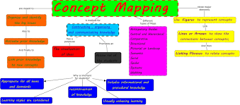
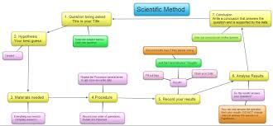

Slide 12
Sourcing Information
Library: Physical and Electronic (EBSCO);
Books: Encyclopaedias, biographies, yearbooks, atlases, dictionaries, etc.
Academic texts books
Internet (take note of URL)
Journals
Newspapers
Leaflets
Transcripts from radio or TV programmes

Slide 13
BOOKS
Encyclopedias
Dictionaries
Atlas
Yearbooks
Journals
Newspapers
Leaflets
Transcripts from radio or TV programs
Others

Slide 14
Internet Sources:
There is tremendous volume of information available online.
Since the internet is almost an all comers place where information can be published quickly by anyone, be vigilant in choosing reliable sources.

Slide 15
Internet Sources…
Generally domain names like “ac.” or “edu.” are educational establishments.
For beginners in research, you may find it easy and useful to use Google Scholar search since it returns results from books, journals, and other academic sources. http://scholar.google.com/.

Slide 16
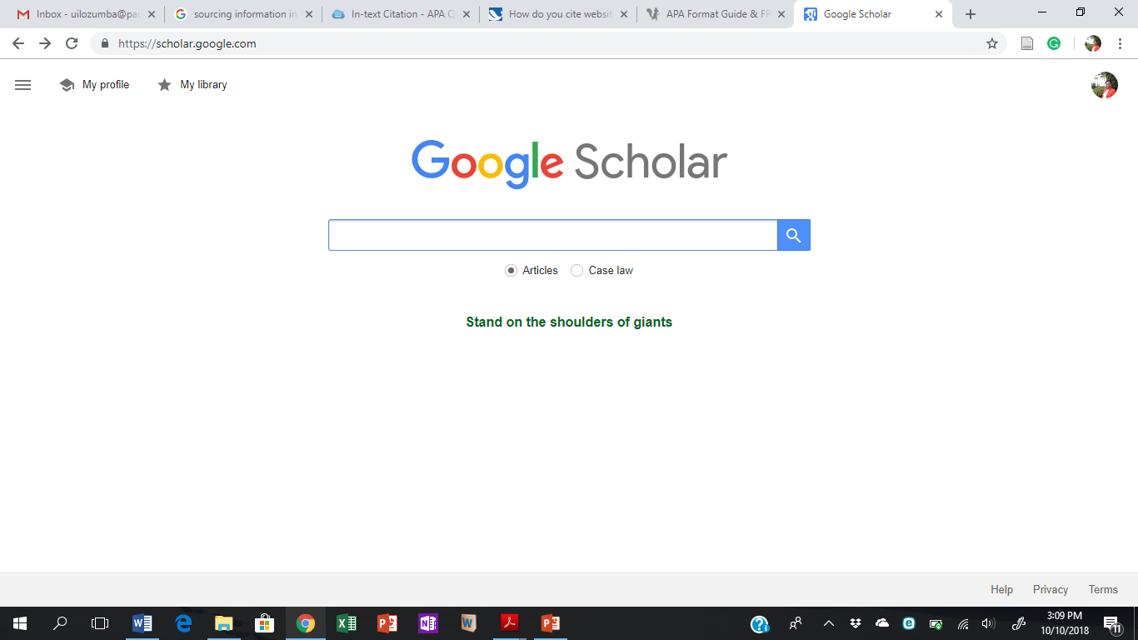
Basics on Google Search
https://scholar.google.com/

Slide 17
Other sources
Bibliographies: Since you will most likely be dealing with ideas that other people have researched on, check the bibliographies of core texts or related books.
Ideas from colleagues: It pays to discuss your study with friends and family – you will often find that they have some useful things to help you with.

Slide 18
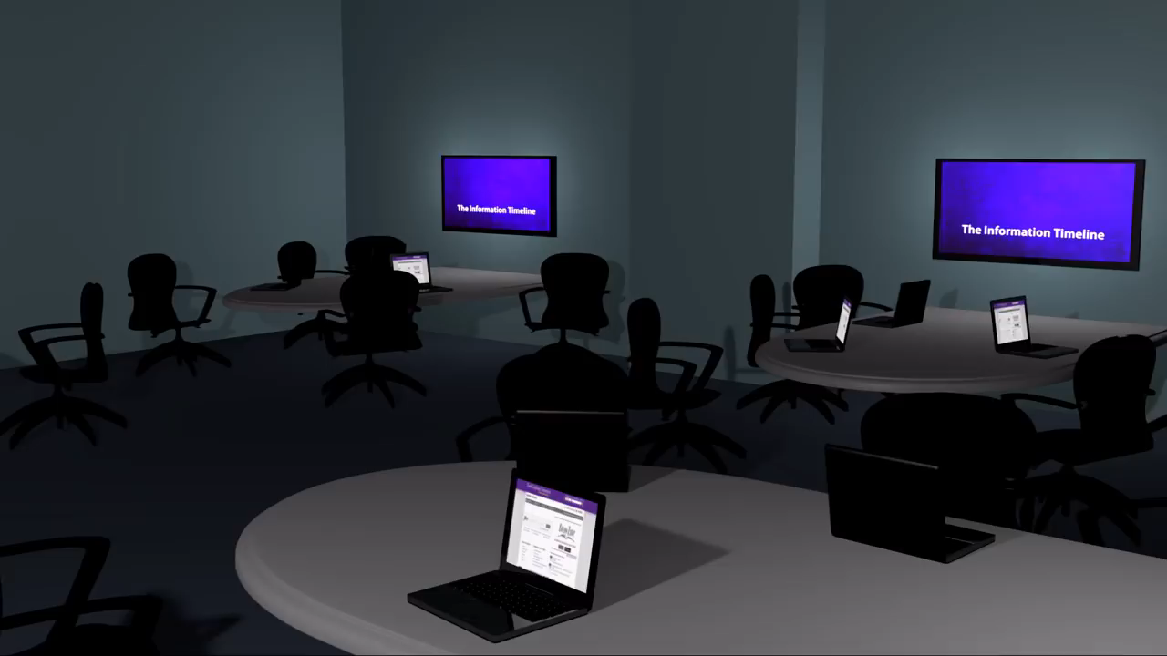
All about Information Timeline

